Slide 1

CSS 3
Transitions and Animations

Slide 2
NEW IN CSS 3

Slide 3
NEW IN CSS 3
New styles
Transforms
Transitions
Animations

Slide 4
New styles
border-radius
box-shadow
text-shadow
rgba / hsla
gradients

Slide 5
Transforms
scale
rotate
skew
translate 2D
translate 3D

Slide 6
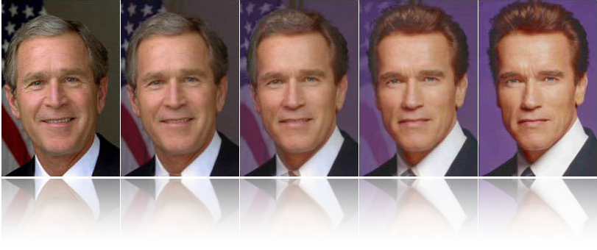
Transitions
Change between states gradually in time

Slide 7
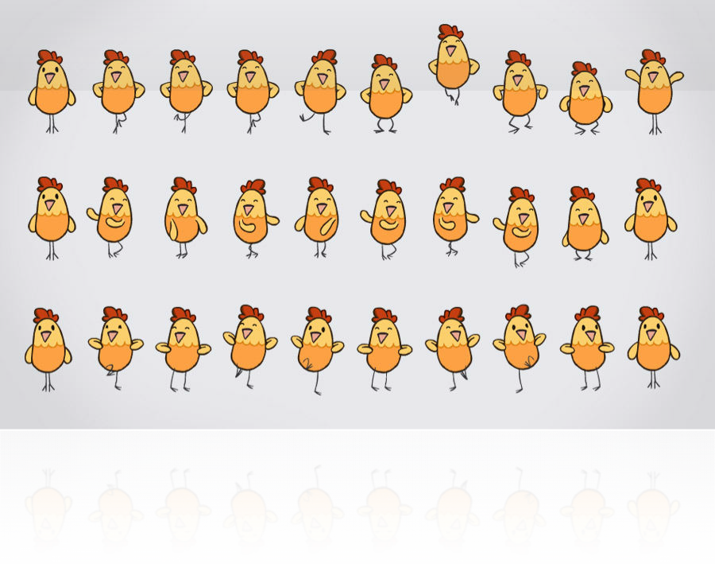
Animations
Automatic transition through states (keyframes) deﬁned in a time line

Slide 8
Any doctype
CSS 3 works on any version of x/html HTML 5, HTML 4, XHTML 1, etc.

Slide 9

BROWSERS

Slide 10











BROWSER SUPPORT
10+
All
All
All
12+
IE 9: Basic
IE 8, 7, 6: No

Slide 11
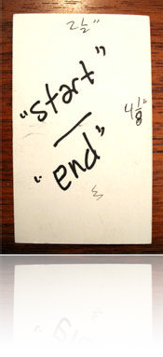
A transition is about animating the change of value of one or more element properties in a given time.

Slide 12
SO WE NEED TO...
Consider an element in the DOM
Deﬁne what element properties to transition
Deﬁne in how much time the properties will change
Deﬁne a ﬁnal state for the element properties

Slide 13

CONSIDER AN ELEMENT IN THE DOM
Using a CSS selector.
I.g.:All the links in the page
a {}

Slide 14


DEFINE IN HOW MUCH TIME THE PROPERTIES CHANGE
Using the “transition-duration” property
a {
transition-duration: 1s;
}

Slide 15


DEFINE WHAT ELEMENT PROPERTIES TO TRANSITION
Using the “transition-property” property
a {
transition-duration: transition-property:
1s; color;
}

Slide 16
DEFINE A FINAL STATE FOR THE ELEMENT PROPERTIES
3 possible ways:
Using an auto-applied pseudo class
Using a class
Using Javascript

Slide 17
FINAL STATE WITH A PSEUDO-CLASS
a:hover {
color: red;
}
The link color will transition to red on mouseover state

Slide 18
FINAL STATE WITH A CLASS
a.selected {
color: black;
}
The link color will transition to black when the selected class is applied to it

Slide 19

WHAT ABOUT ANIMATIONS?

Slide 20
WHAT ARE ANIMATIONS
Animations allow us to deﬁne states in time (keyframes) and transition through them

Slide 21
CSS ANIMATIONS
Name an animation
Deﬁne a set of keyframes
Deﬁne the CSS properties for each frame
Apply the animation in time
= Automatic transition bewteen keyframes

Slide 22
DECLARATION
Deﬁning the animation “bounceThenFly”
@keyframes bounceThenFly { 0%
10%
20%
30%
40%
50%
50.01%
98%
}
{ background-position:
{ background-position:
{ background-position:
{ background-position:
{ background-position:
{ background-position:
{ background-position:
{ background-position:
-13px
-7px
-13px
-7px
-13px 40px
-35px
-13px
42px }
30px } 42px }
30px } 42px }
-60px }
120px } 42px }

Slide 23
DECLARATION
(each keyframe can be more complex)
@keyframes anotherAnimation {
// ... 50% {
background-color: red; color: white;
text-shadow: 0 0 10px black;
}
// ...
}

Slide 24
USAGE
The #rocket element will use the animation “bounceThenFly” during a time of 5 seconds, and repeat it inﬁnitely
#rocket {
animation-name: bounceThenFly; animation-duration: 5s;
animation-iteration-count: infinite;
}

Slide 25
USAGE
Less characters = happier coders & lighter CSS
#rocket {
animation: bounceThenFly 5s infinite;
}

Slide 26






USAGE
Less characters = happier coders & lighter CSS
#rocket {
animation:
bounceThenFly
5s infinite;
}
animation-name
animation-duration
animation-iteration-count

